Slide 1
CAPSTONE PROJECT
CREDIT CARD DEFAULT PREDICTION
TEAM MEMBERS
Adil Khan,
Sunil Panigrahi,
Shubham Kumar,
Vivek Singh,
Sharaffin B

Slide 2
POINTS TO DISCUSS
Problem Statement
Abstract
Data Summary
Data Pipeline
Exploratory Data Analysis
Observations on EDA
Model building
Comparison of models used
Conclusion

Slide 3
PROBLEM STATEMENT
The fundamental objective of the project is to analyze credit card data collected from Taiwan-based credit card issuer and predict whether or not a consumer will default on their credit cards, as well as identify the key drivers behind this. This would inform the issuer’s decisions on who to give a credit card.

Slide 4
ABSTRACT
Credit risk plays a major role in the banking industry business. Bank’s main activities involve granting loan, credit card, investment, mortgage, and others. Credit card has been one of the most booming financial services by banks over the past years. However, with the growing number of credit card users, banks have been facing an escalating credit card default rate. Also, many customers used their credit card beyond their repayment capabilities leading to high debt accumulation. This situation creates a problem for the bank. With the help of historical data, the need to predict bank loan error can be determined. As such, machine learning offers solutions for addressing the current issue and handling credit risk, Thus this project used ML algorithms of classification to get predictions with accuracy to detect the default users based on previous six months data.

Slide 5
DATA SUMMARY
The provided data set has following different columns of over 25 variables and they are given below
CATEGORICAL VARIABLES
GENDER - [1 – Married ,2 – Single, 3 – Others]
EDUCATION- [ 1 – Graduate School,
2 – University ,
3 – High School, 4 – Others ]
MARRIAGE - [ 1 – Married, 2 – Single ,3 – Others]
REPAYMENT HISTORY
PAY_1 – September
PAY_2 – August
PAY_3 – July
PAY_4 – June
PAY_5 – May
PAY_6 – April
DEFAULT - [ 1- YES , 0 - NO ]

Slide 6
NUMERICAL VARIABLES
LIMIT_BALANCE - Amount of Credit given in New Taiwan Dollars
AGE - Age in years
BILL AMOUNT
BILL_AMT1 – September
BILL_AMT2 – August
BILL_AMT3 – July
BILL_AMT4 – June
BILL_AMT5 – May
BILL_AMT6 – April
PAY_AMOUNT
PAY_AMT1 – September
PAY_AMT2 – August
PAY_AMT3 – July
PAY_AMT4 – June
PAY_AMT5 – May
PAY_AMT6 – April

Slide 7


DATA PIPELINE
DATA CLEANING
Understanding and
Cleaning
EDA
MODELLING
We checked for missing values, column type, column name, duplicate records, identified outliers, numerical categorical data and cleaned the dataset for EDA
Exploratory data analysis using tables and graphs to derive the observations from the data
●Logistic
●SVM
●Bagging classifier
●Random Forest
●GBC
●XGBoost

Slide 8
EXPLORATORY DATA ANALYSIS
After Cleaning the data set, we did some exploratory data analysis using tables and graphs to derive the observations from the data and get the solution to the problem statement.
While doing EDA we tried to answer few questions below using univariate, bivariate and Multivariate Analysis.

Slide 9
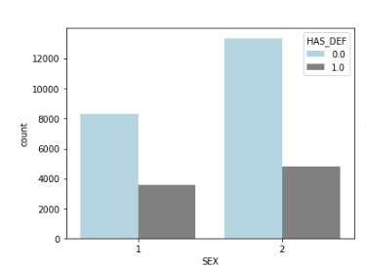
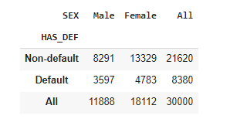
1. Is the proportion of defaults the same for men and women?
The data set contains 11888 males and 18112 females. 30% male have default payment while 26% female have default payment The proportion of defaults for men is slightly higher than the proportion of defaults for women.

Slide 10
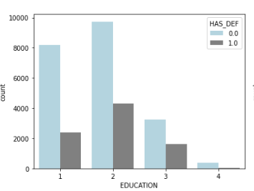
2. Did customers with higher education have less number of delayed payment?
The proportion of defaults seems to decrease as the level of education increases.Customers with high school and university educational level had higher default proportions than customers with grad school education. More number of credit holders are university students followed by Graduates and then High school students

Slide 11
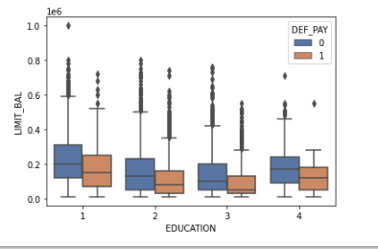
3. Did customers with a higher education level get higher credit limits?
clients who have lower than high school level education tend to have default payment more.

Slide 12
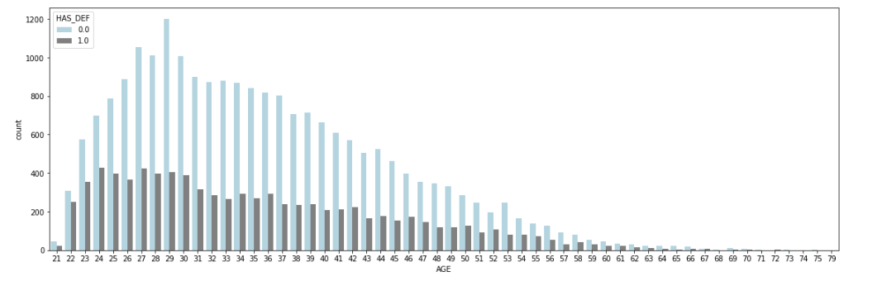
4. Does age has any relation with Credit Limit and Default Payments
There are more adults as compared to old people above 40 and below 60
There are very low senior citizens
Customers aged between 30-50 had the lowest delayed payment rate, while younger groups (20-30) and older groups (50-70) all had higher delayed payment rates. However, the delayed rate dropped slightly again in customers older than 70 years.

Slide 13
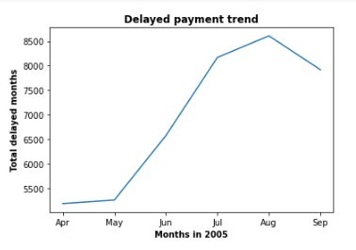
5. Has the repayment status changed in the 6 month from April 2005 (PAY_6) to September 2005(PAY_1)?
There was a huge jump from May,2005 (PAY_5) to July, 2005 (PAY_3) when delayed payment increased significantly, then it peaked at August, 2005 (PAY_2), things started to get better in September, 2005 (PAY_1).

Slide 14
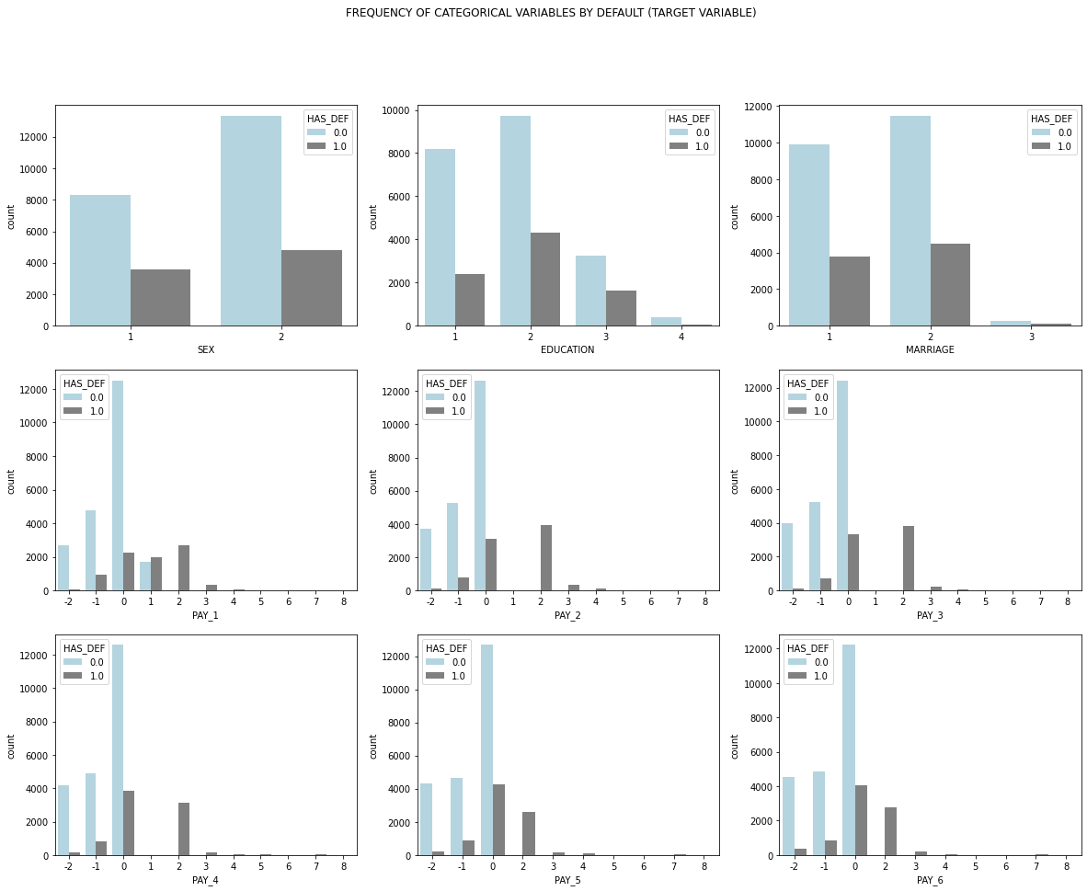
BIVARIATE ANALYSIS

Slide 15
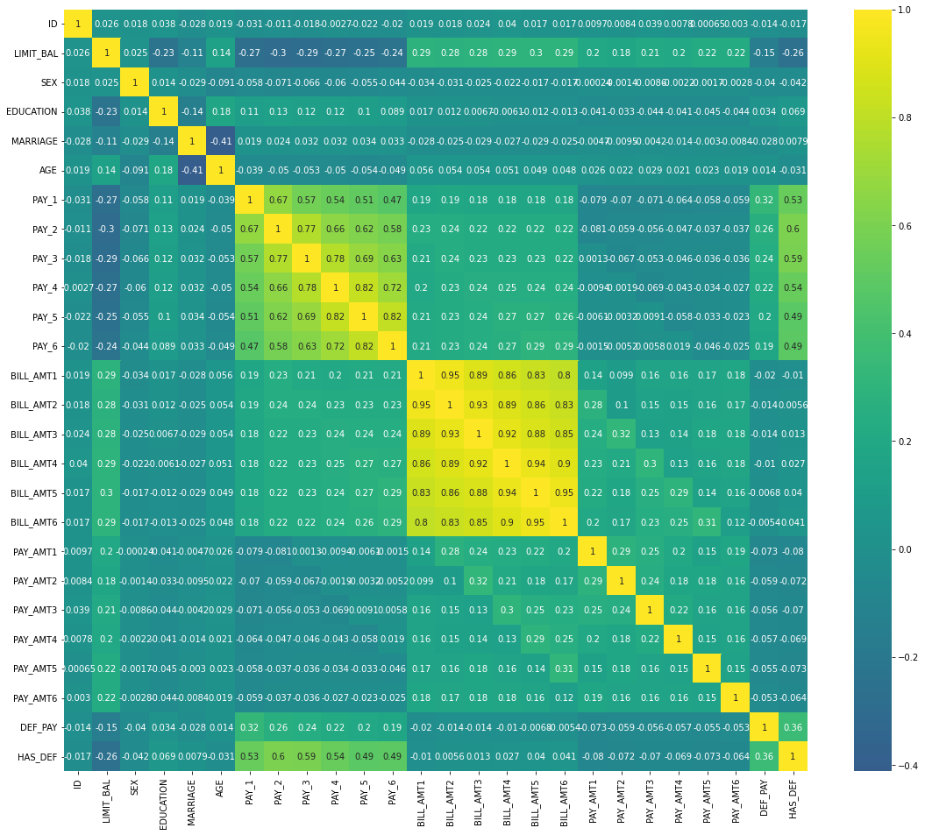
Heat Map for Multicollinearity
"age" is inversely correlated with "Marriage".
the bill amounts from April to September are highly positively correlated.
Multicollinearity exists between the payment status variables.
Moreover, the bill amounts of each month are weakly positively correlated or even NOT correlated to the payment amount of the same month, meaning that the customers are not paying the exact amount of their bills.
The payment status(PAY_1 TO PAY_6) and credit limit(LIMIT_BAL) are negatively correlated, i.e. the later the repayment, the lower the credit limit.
The credit limit is inversely correlated with the customer having a default payment next month.

Slide 16
MODEL BUILDING
Tuning
Data
Preprocessing
Data Fitting and
Tuning
Model Evaluation
Train test data split(80%-20%)
●Start with default
model parameters
●Hyperparameter
tuning
●Model testing
●Precision, Recall
Score
●Compare with the
other models

Slide 17
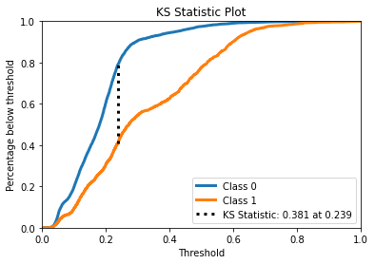
LOGISTIC CLASSIFICATION
Accuracy on train data: 0.81025
Accuracy on test data: 0.80883
Precision: 0.7163461538461539
Recall: 0.22456669178598343
Parameters
'C': 1.0,
'penalty': 'l2',
'solver': 'newton-cg'

Slide 18
SUPPORT VECTOR CLASSIFICATION
PARAMETERS
C': 1.0,
'gamma': 'auto',
'kernel': 'rbf
Accuracy: 0.7886666666666666
Precision: 0.7322834645669292
Recall: 0.07008289374529013

Slide 19
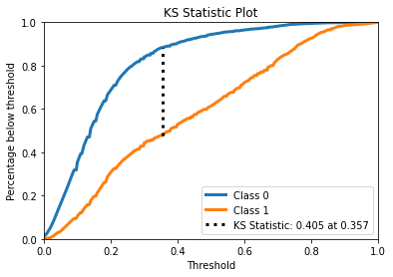
RANDOM FOREST CLASSIFIER
Accuracy: 0.8135
Precision: 0.6357702349869452
Recall: 0.36699321778447624
BEST PARAMETER
n_estimators': 1000

Slide 20
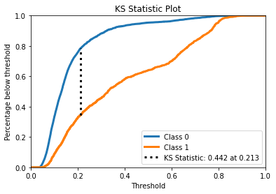
GRADIENT BOOSTING ALGORITHM
Accuracy: 0.8186666666666667
Precision: 0.665742024965326
Recall: 0.3617181612660136
Parameters
learning_rate: 0.1,
max_depth: 3,
n_estimators: 50,
subsample: 0.5

Slide 21
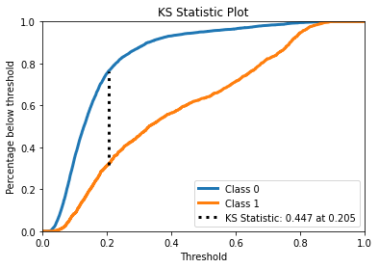
XGBOOST
The accuracy on Trained data-0.8256666666666667
The accuracy on test data is 0.8213333333333334
The precision on test data is 0.36623963828183875
The recall on test data is 0.6778242677824268
Parameters -

Slide 22
BAGGING CLASSIFIER
Performance Metrics
Accuracy: 0.8125
Precision: 0.6268844221105527
Recall: 0.3760361718161266
PARAMETERS
'n_estimators': 45

Slide 23
Comparisons on Models
ML Algorithms | Accuracy on Trained Data | Accuracy on Test Data | Precision | Recall
Logistic classification | 0.81025 | 0.8088 | 0.7163 | 0.2245
Support vector Classification | 0.7886 | 0.7734 | 0.7322 | 0.0700
Random Forest classifier | 0.8126 | 0.8135 | 0.6570 | 0.3669
Gradient Boosting Classifier | 0.8102 | 0.8226 | 0.6886 | 0.3617
XGBoost | 0.825 | 0.8213 | 0.3662 | 0.6778
Bagging Classifier | 0.7996 | 0.8125 | 0.6268 | 0.3760

Slide 24
CONCLUSION
The dataset was not normally distributed and mostly it was right skewed
There is NO significant difference in the proportion of default payment across different education levels. But clients who have lower than high school level education tend to have default payment more.
Married clients have a higher default payment rate than single or other marital status clients.
People who have the payment delay for two months have a high ratio of default next month (October). In September, a quarter of customers who repay one month later have default payment next month in October. This situation does not exist in other months as almost no one repay one month later
The developed models took into account all possible factors and data. This final chosen model would benefit the bank before they make any decisions against that customers.
XGBOOST has the highest accuracy of 82.5 % with a recall of 67.7 % and KS chart value of 0.447.

